Slide 1
REVISION FOR MIDTERM II

Slide 2
Present simple – Verb BE
Where | is | your surname from?
Where | are | my glasses?
When | is | the English class?
What time | is | our English class?
My surname is from Italy.
They are on the table.
It is on Mondays and Wednesdays.
It is at 11:00 a.m.

Slide 3
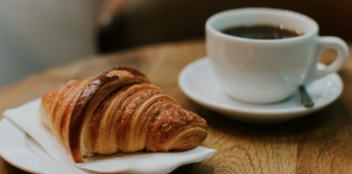
Present simple – Verb BE
How | are | you ?
How old | are | you ?
How much | is | a coffee and a croissant?
I’m fine. Thanks!
I’m twenty years old.
It is 700 pesos.

Slide 4
Present simple – Verb BE
Is | your mother | at home?
Is | the series | interesting?
Are | these series | interesting?
Is | your house | big?
Yes, she is.
Yes, it is. / No, it isn’t.
Yes, they are.
No, it isn’t. It’s small.

Slide 5
What | do | you | do?
What food | do | you | like?
What kind of books | do | you | read?
What TV programmes | do | you | watch?
How many brothers and sisters | do | you | Have ?
I’m a teacher.
I like Italian food.
I read science books.
I watch sports programs on TV.
I have two sisters.

Slide 6
Present simple
 | Do | you | like sushi?
 | Does | he | want to go abroad?
 | Do | they | need to study hard ?
 | Does | it | work?
Yes, I do. I love sushi.
Yes, he does. He wants to go abroad.
Yes, they do. They need to study hard.
Yes, it does. It works perfectly well.

Slide 7
Was | your mother | at home yesterday?
Was | the series | interesting?
Were | the students | stressed?
Was | Your grandfather | Italian?
Why
Where
were | the students | stressed?
was | your grandfather | born?
Yes, she was. No, she wasn’t.
Yes, it was.
Yes, they were. Because they had exams.
Yes, he was. He was born in Ancona.

Slide 8
last year - last month - last week – yesterday - last night - two days ago - two minutes ago - a year ago
Where | did | you | go?
What | did | you | do?
How | did | you | travel?
Where | did | you | stay?
I went to Paris.
I went sightseeing and I took lots of photos.
I travelled by plane.
I stayed in a hotel/ I stayed with friends.

Slide 9
last year - last month - last week – yesterday – last night - two days ago - two minutes ago - a year ago
Did | you | have | a good time?
Did | she | buy | souvenirs?
Did | they | go out | at night?
Did | he | have | any problems?
Yes, I did. I had a fantastic time.
Yes, she did. She bought lots of souvenirs.
Yes, they did. They went out every night.
No, he didn’t. He didn’t have any problems at all.

Slide 10
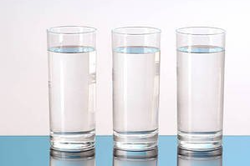
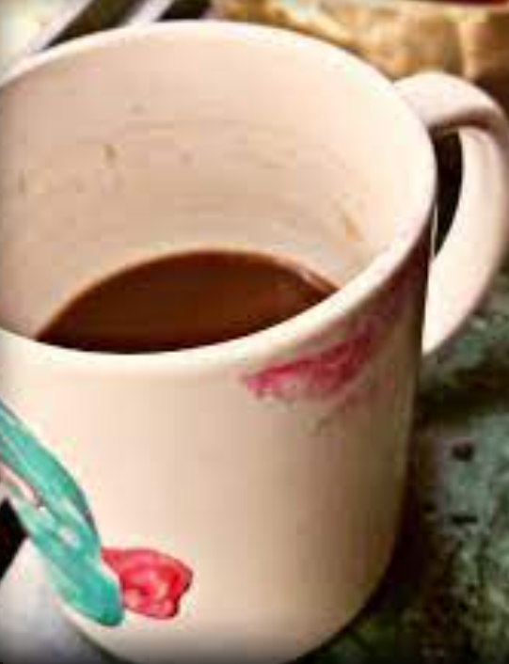
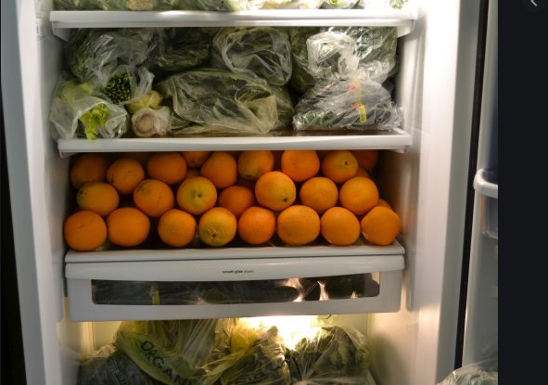
How many glasses | are | there?
How much coffee | is | there ?
How many oranges | are | there in the fridge?
There are three glasses.
There is a little coffee.
There are lots of oranges in the fridge

Slide 11


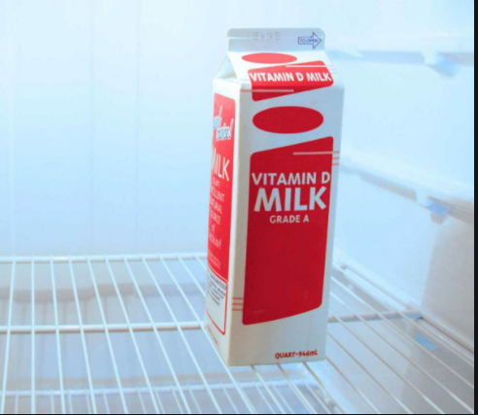
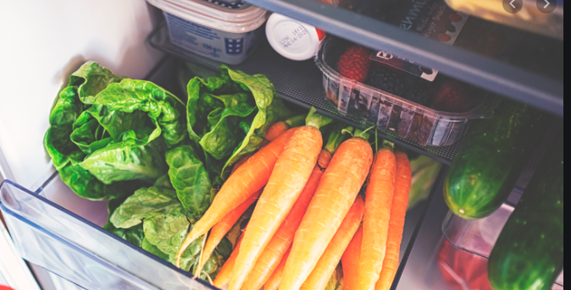
When | is | there a holiday ?
What | is | there on your table ?
What | is | there in the fridge?

Slide 12
Is | there | a bathroom upstairs?
Are | there | any glasses on the table?
Is | there | any sugar in the bowl?
Are | there | any flowers in your garden?

Slide 13
Was | there | a good show on tv yesterday?
Was | there | good food at the party?
Were | there | many people at the hotel?
Was | there | a lot of traffic at midday?

Slide 14
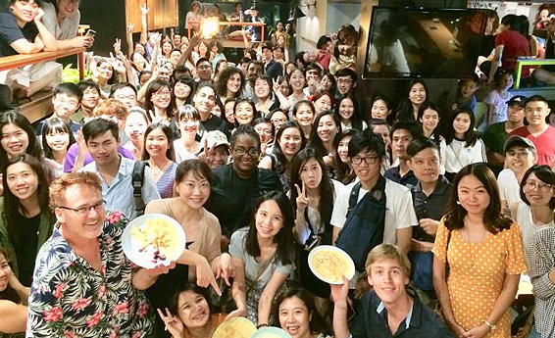
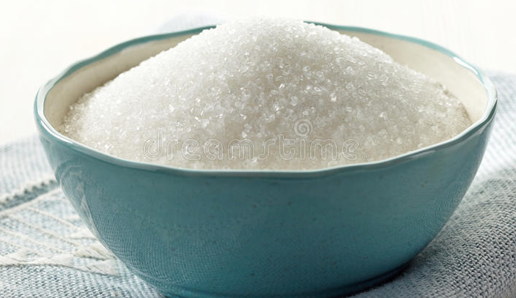
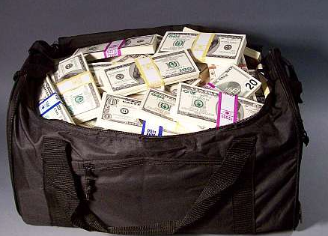
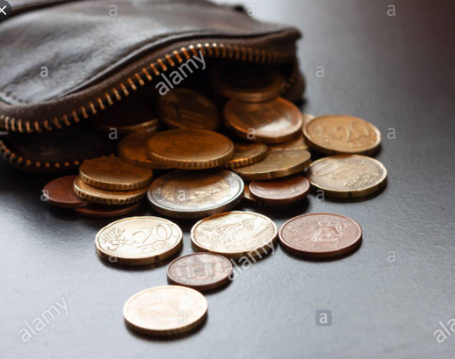
How many people | were | there | at the party?
How much sugar | was | there | in the bowl?
What | was | there | in the bag?

Slide 15
Likes and dislikes (V+ing)
What | do | you | like | doing in the summer?
What kind of films/shows What film | does does does | she she she | love love want | seeing? watching on TV? to see tonight?
Where Where | do are | they they | like planning | spending their holidays? to spend their holidays?
 | Does | he | like | meeting his friends?
I like going to the pool in the summer.
She loves seeing romantic comedies. She likes watching romantic comedies on tv.
She wants to see Love again tonight. They like spending their holidays abroad.
They are planning to spend their holidays abroad. Yes, he does. He loves meeting his friends.

Slide 16
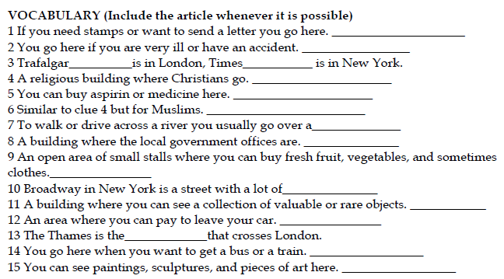
PLACES AND BUILDINGS

Slide 17
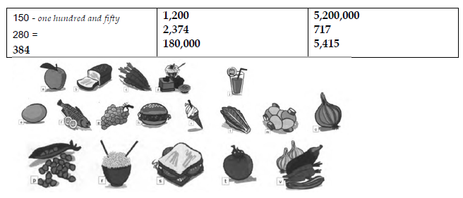
HIGH NUMBERS
FOOD

Slide 18
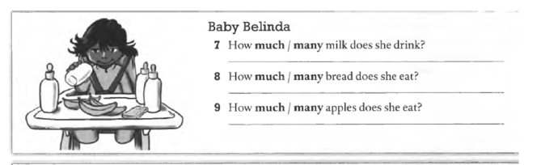
HOW MUCH/ HOW MANY
COUNTABLE AND UNCOUNTABLE NOUNS

Slide 19
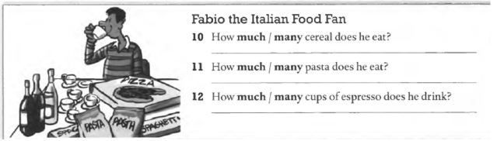
HOW MUCH/ HOW MANY
COUNTABLE AND UNCOUNTABLE NOUNS

Slide 20
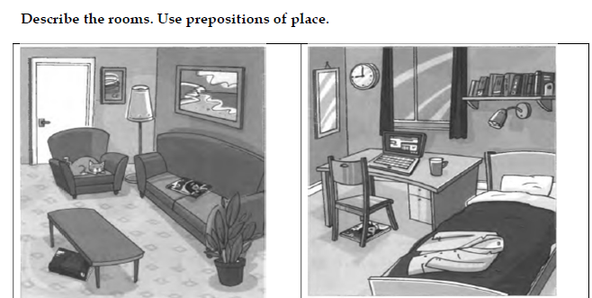
THE HOUSE - PREPOSITIONS

Slide 21
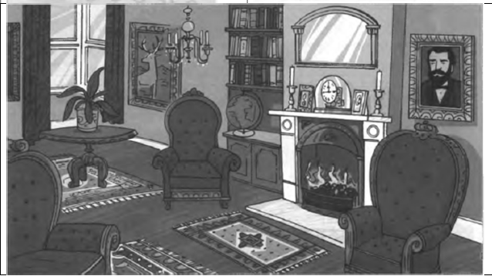
THE HOUSE - PREPOSITIONS

Slide 22
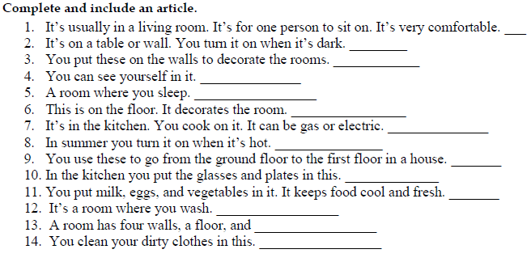
THE HOUSE – A/AN

Slide 23
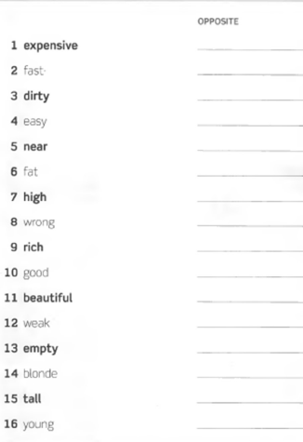
ADJECTIVES

Slide 24
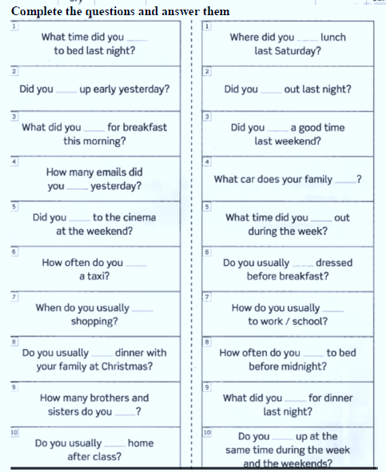
SIMPLE PRESENT /
SIMPLE PAST –
TIME EXPRESSIONS

Slide 25
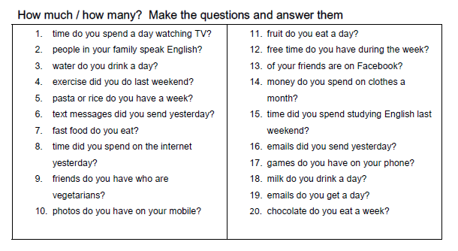
HOW MUCH / HOW MANY / COUNTABLE AND UNCOUNTABLE NOUNS.

Slide 26
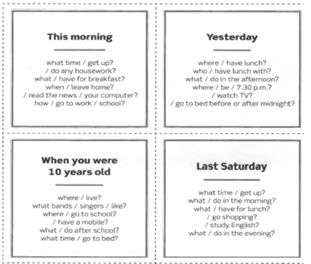
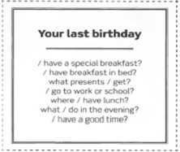
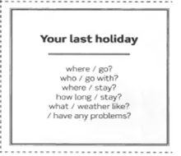
SIMPLE PAST

Slide 27
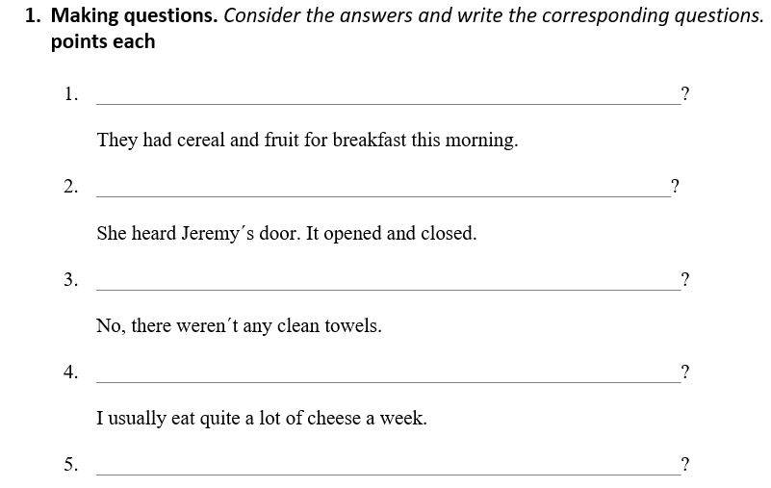

Slide 28
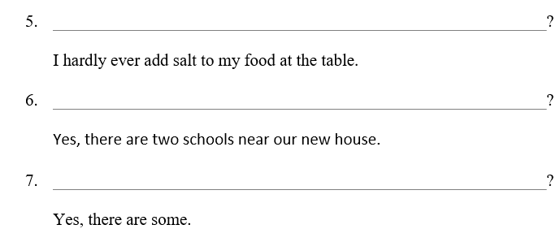
Yes, I do. I always add salt to my food at the table.
There are two schools near our house.
Yes, there are some shelves on the walls.

Slide 29
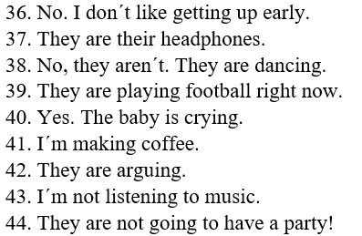
Make questions for these answers

Slide 30
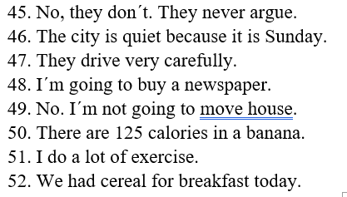
Make questions for these answers

Slide 31
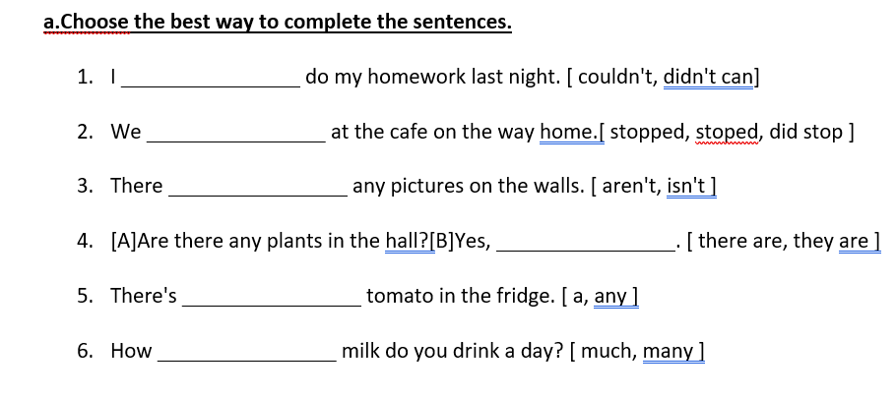

Slide 32
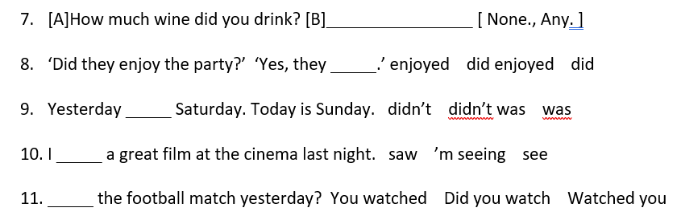

Slide 33
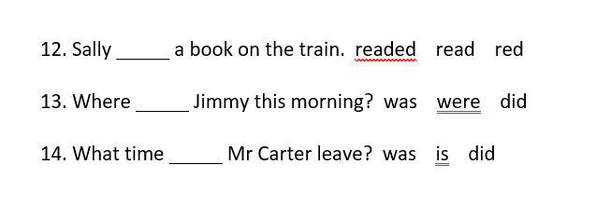

Slide 34
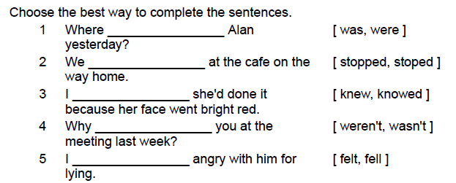

Slide 35
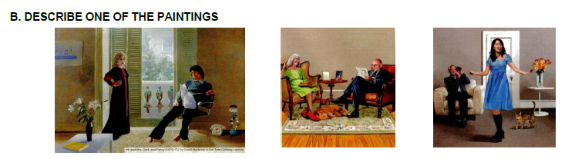
Use there is/there are/ prepositions of place/ and present continuous

Slide 36
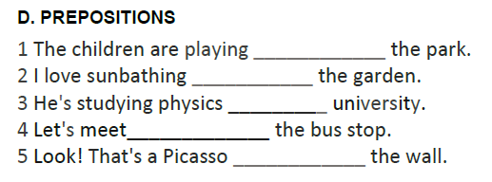

Slide 37
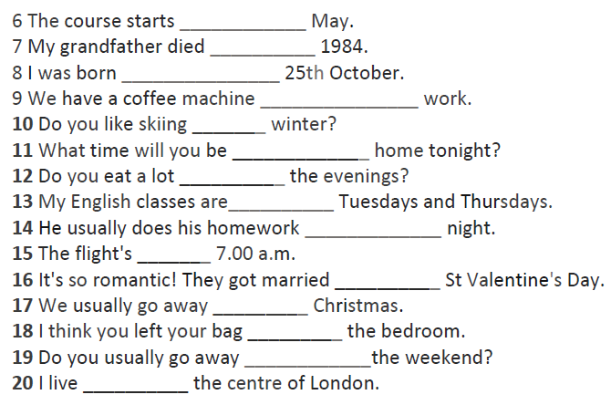

Slide 38
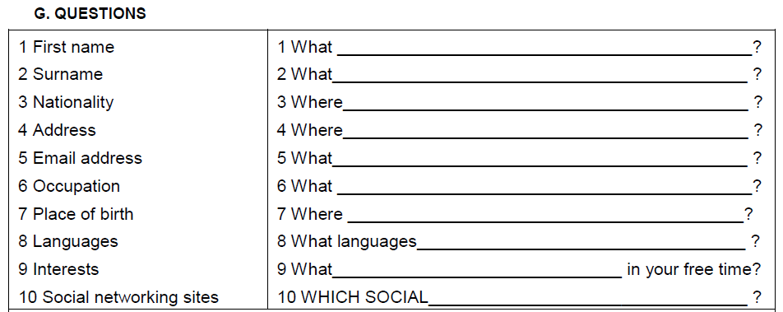

Slide 39
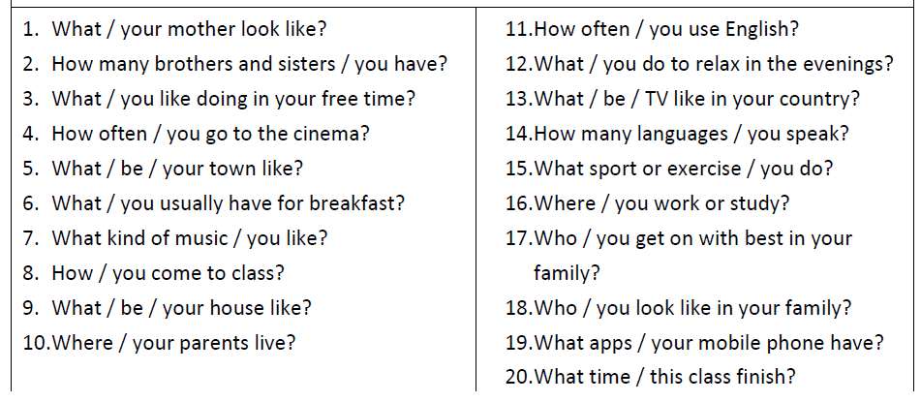

Slide 40
